Slide 1
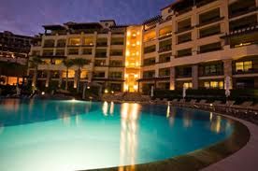
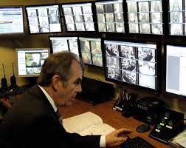
Description
The job duties and responsibilities of a security guard are not the same as a peace officer or police officer. Instead, security guards are in the prevention business. It is their job to act as a deterrent to crime, to watch for impending danger and to report crimes they may encounter.
Hotel security officers work in pairs, groups or individually, depending on the size and demands of the property. They have varied tasks but spend the majority of their time patrolling the property, checking stairwells and generally overseeing an area. Although most security officers don’t carry weapons, they often have access to firearms in cases of extreme emergency.
Electronic surveillance incorporates a significant part of security operations in many hotels. Security officers often spend time monitoring and observing the property via surveillance equipment, which allows them to watch several areas at once.
A hotel security officer usually performs the following tasks:
•Respond to individual guest needs and concerns.
•Patrol property, both inside and outside.
•Check security locks and alarms on doors and stairwells.
•Escort guests as needed.
•Monitor surveillance cameras.
•Submit written reports.
•Work cooperatively with local law enforcement.

Slide 2
What does security guard do for the customer
Stand guard
A security guard at an entryway, roaming a mall corridor or riding an elevator represents safety and security.. Security guards are typically asked to greet passers-by, to be friendly to people who need directions and to hold doors open for those in need of assistance
Assist in First Aid
Security guards sometimes are asked to assist with first aid. If a person slips and falls, chokes or is having respiratory problems, a security guard may be asked to help the individual with minor first-aid techniques. The role may require the security guard to know CPR or simple first aid. Someone who is attempting to get a job as a security guard would benefit from first-aid training.

Slide 3
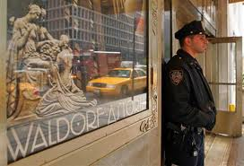
Salary
Depending on the type of employment, a hotel security officer may be paid by the hour or by salary. Hourly security personnel have the opportunity to work more shifts and possibly earn overtime compensation.
According to the U.S. Bureau of Labor Statistics, security guards make a median annual wage of $23,820, as of May 2009. Those who work in specific industries, such as natural gas or computer systems, earn up to $64,000 annually, the BLS says.

Slide 4
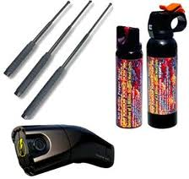
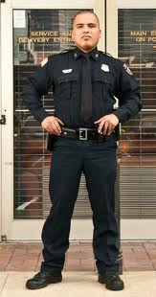
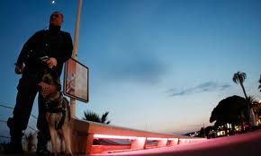
Qualifications for this position
No formal education is required to be a hotel security guard.
high school diploma
G.E.D. hotels will provid
specific training to security guards
Many security guards have taken college courses in law enforcement
larger hotels often require their head security guard to have a college diploma in law enforcement or a similar program.
The society's voluntary training guidelines suggest that new guards receive at least 48 hours of training within the first 100 days of starting the job.
Security guards wear uniforms, which are easily recognizable to the public at large. They also have badges as part of their uniforms. The uniform of a security guard is another way to stop crime and unlawful entrant by a criminal. When someone sees a security guard he is less likely to attempt a crime. You are going to find that some security guards will carry guns and others have no weapon at all. They carry handcuffs, mace and other items designed to help assist them with the performance of their job duties.

Slide 5
Vocabulary
median : noting or pertaining to a plane dividing something into two equal parts, especially one dividing an animal into right and left halves.
Compensation: something given or received as an equivalent for services, debt, loss, injury, suffering, lack, etc.; indemnity: The insurance company paid him $2000 as compensation for the loss of his car.
respiratory problems: pertaining to or serving for respiration: respiratory disease.
cooperatively : working or acting together willingly for a common purpose or benefit.
Varied : characterized by or exhibiting variety; various; diverse; diversified: varied backgrounds.
2. changed; altered: a varied estimate.
http://www.ehow.com/about_5403116_duties-security-guard.html
http://www.ehow.com/list_6069747_basic-duties-security-guard_.html

